Slide 1
Dynamic Memory Allocation in C
Dr. Sheak Rashed Haider Noori
Assistant Professor

Slide 2
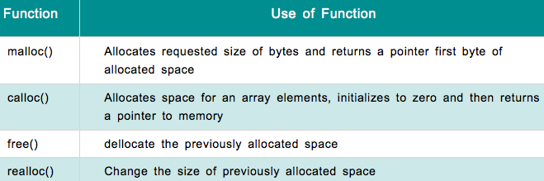
Dynamic Memory Allocation in C
In C language there are 4 library functions under "stdlib.h" for dynamic memory allocation.

Slide 3
malloc()
The name malloc stands for "memory allocation”. The function malloc() reserves a block of memory of specified size and return a pointer of type void which can be casted into pointer of any form.
Prototype:
void * malloc(size in byte);
Syntax:
ptr=(cast-type*)malloc(byte-size);
Here, ptr is pointer of cast-type. The malloc() function returns a pointer to an area of memory with size of byte size. If the space is insufficient, allocation fails and returns NULL pointer.

Slide 4
malloc() cont.
Example:
int *ptr;
ptr=(int*)malloc(100*sizeof(int));
This statement will allocate either 200 or 400 according to size of int 2 or 4 bytes respectively and the pointer points to the address of first byte of memory.

Slide 5
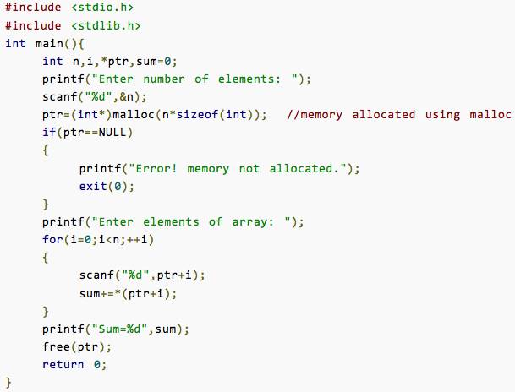
Code Example of malloc()
Problem:
Write a C program to find sum of n elements entered by user. To perform this program, allocate memory dynamically using malloc() function.

Slide 6
calloc()
The name calloc stands for "contiguous allocation".
The difference between malloc() and calloc() is that, calloc() zero-initializes the memory blocks, while malloc() leaves the memory uninitialized.
Prototype:
void *calloc (no_of_blocks, size_of_each_block_in_bytes);
Syntax:
ptr=(cast-type*)calloc(no_of_blocks, size_of_each_block_in_bytes);
This statement will allocate contiguous space in memory for an array of n elements.

Slide 7
calloc() cont.
Example:
float *ptr;
ptr=(float*)calloc(25, sizeof(float));
This statement allocates contiguous space in memory for an array of 25 elements each of size of float, i.e, 4 bytes.

Slide 8
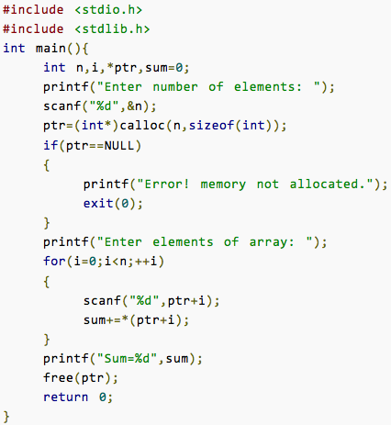
Code Example of calloc()
Problem:
Write a C program to find sum of n elements entered by user. To perform this program, allocate memory dynamically using calloc() function.

Slide 9
free()
Dynamically allocated memory with either calloc() or malloc() does not get return on its own.
The programmer must use free() explicitly to release space taken from the Heap.
Prototype:
void free(pointer to heap memory);
Example:
free(ptr);
This statement cause the space in memory pointer by ptr to be deallocated.

Slide 10
realloc()
The realloc() function changes the size of a block of memory that was previously allocated with malloc() or calloc().
If the previously allocated memory is insufficient or more than sufficient. Then, you can change memory size previously allocated using realloc().
Prototype:
void *realloc(void *ptr, size_t size);
The ptr argument is a pointer to the original block of memory. The new size, in bytes, is specified by size.

Slide 11
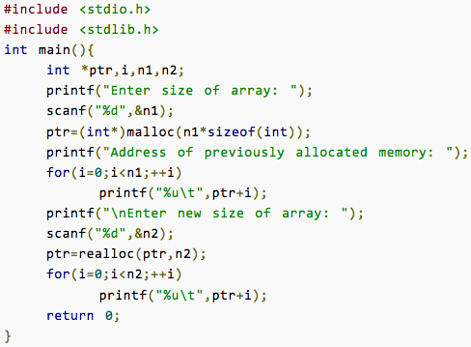
Code Example of realloc()

